Slide 1





Peace of Mind
2022 TRAVELERS MODELING COMPETITION
Classifier Model: Auto Quote Conversion
Dec 14, 2022
Team Rovers
Shailesh Yadav
Ping-Jui Han
Nikhil Uttarwar
Vasudha Mishra
Heedong Park
Notes:
Good morning! We are team Rovers, and we will be presenting about our Classifier Model for the Auto Quote Conversion.

Slide 2
Peace of Mind
AGENDA
Project Objective
Data Cleaning
Exploratory Data Analysis
Model Selection
Model Development
Model Evaluation
Findings
Recommendations
Feature Additions
Task Specialization
2
Notes:
We will first go over project objective, then explain the process of creating our models, along with the outcomes.

Slide 3
Peace of Mind
PROJECT OBJECTIVE
Create a conversion model, with the goal of:
identifying quoted polices that Peace of Mind will convert
understanding key characteristics of policies Peace of Mind tends to write
providing a recommendation on how the information could be leveraged
3
Notes:
Our team was asked to create a conversion model that:
1) identifies converted policies and 2) derives characteristics of the policies that Peace of Mind is likely to write or avoid
Based on the outcome, we will provide recommendations on how to use the information.

Slide 4
Peace of Mind
DATA CLEANING
drivers
policies
vehicles
Removed 63 data points in the driver dataset: age over 100
Checked for consistency in policies dataset: zip codes, state ID, county name
Removed ‘Model’ from Make-Model in vehicle dataset
merged dataset
Merged 3 datasets based on relationships, grouping by policy number
Transformed categorical variables through one hot encoding
29460 rows, 213 columns
4

Slide 5
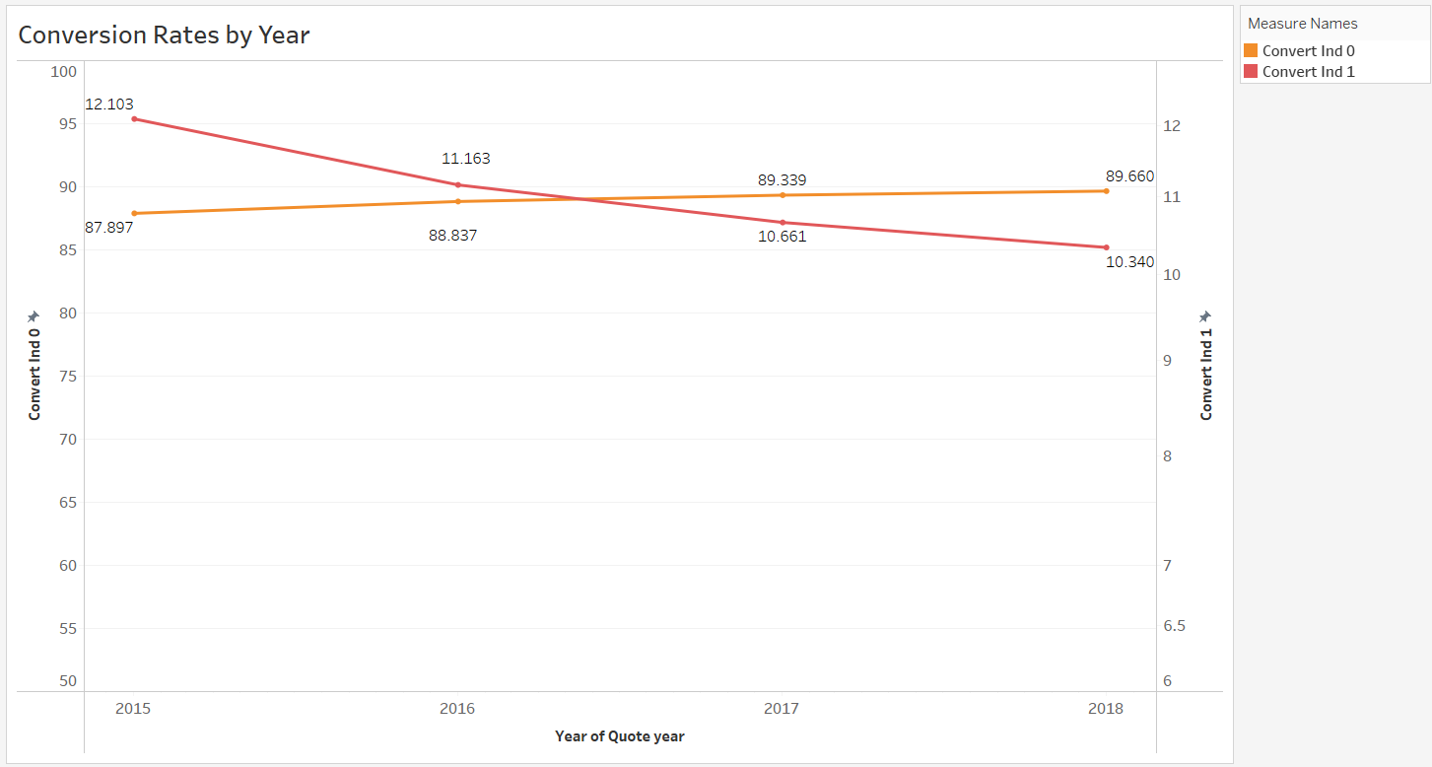
Peace of Mind
EXPLORATORY DATA ANALYSIS
5

Slide 6
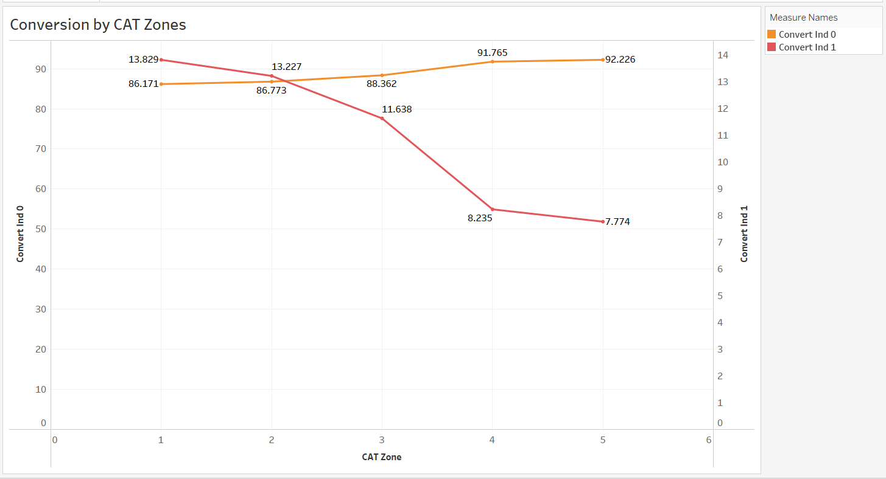
Peace of Mind
EXPLORATORY DATA ANALYSIS
6

Slide 7
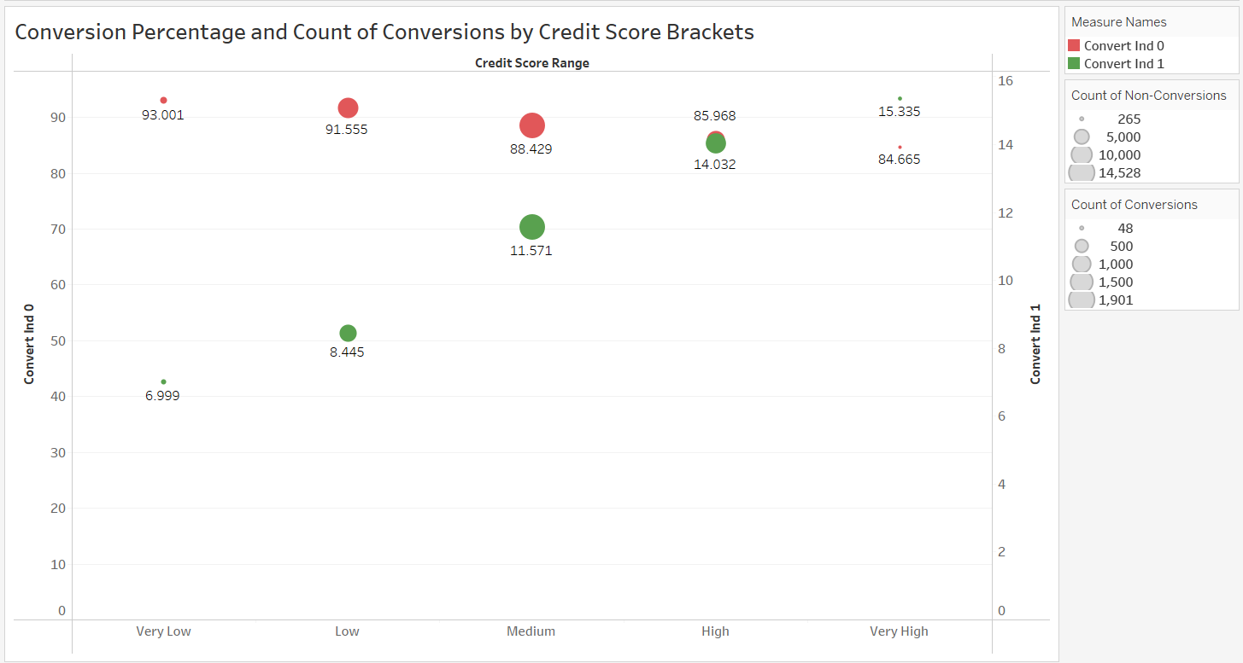
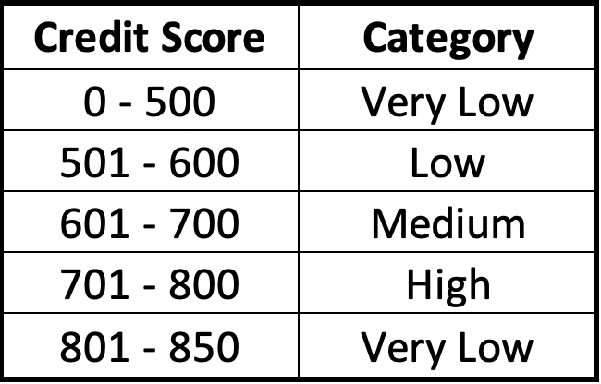
Peace of Mind
EXPLORATORY DATA ANALYSIS
7

Slide 8
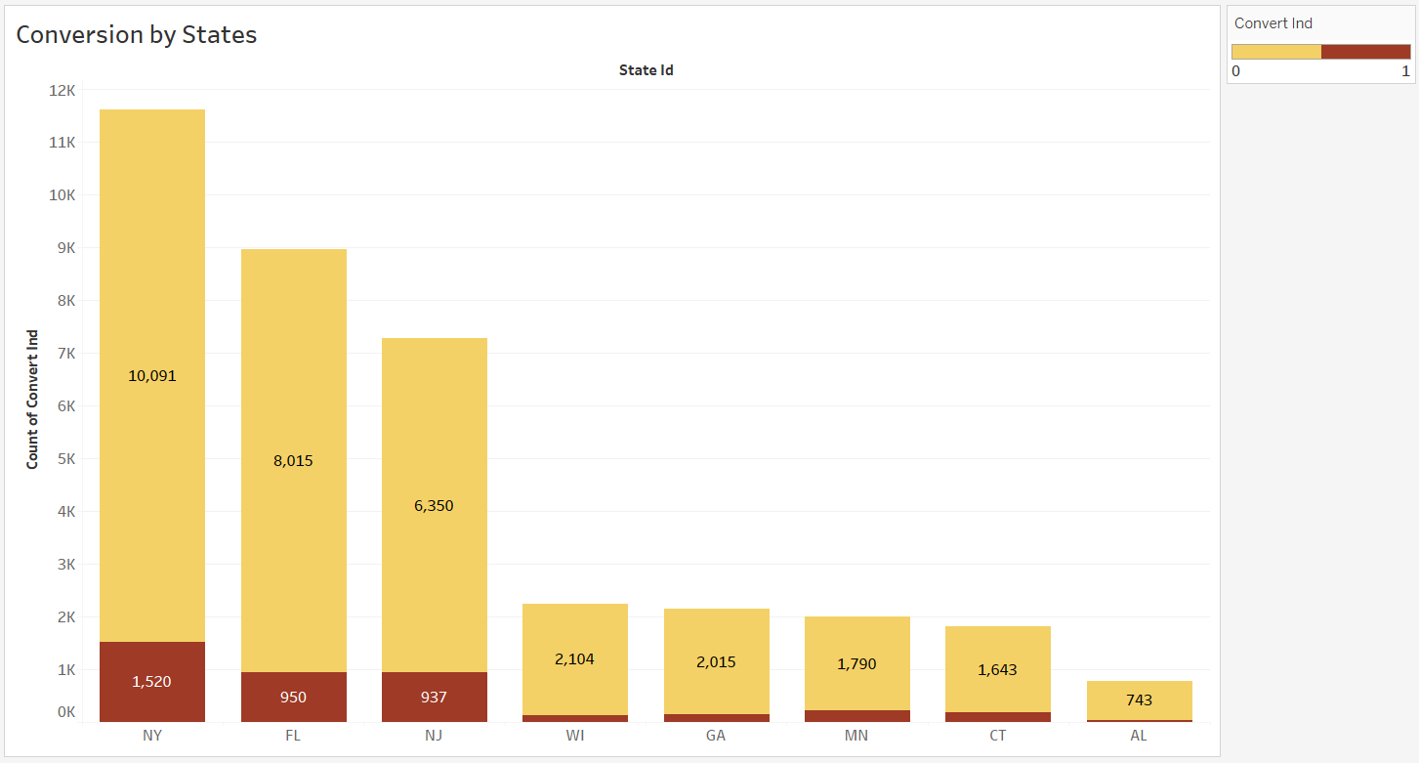
Peace of Mind
EXPLORATORY DATA ANALYSIS
13.1%
10.6%
12.9%
6.1%
6.5%
11%
10%
4.5%
8

Slide 9
Peace of Mind
MODEL SELECTION
Peace of Mind Insurance
Training 80%
Validation 20%
Logistic Regression
LightGBM
XGBoost
top AUC !
hyperparameter tuning
9

Slide 10
Peace of Mind
MODEL DEVELOPMENT
Fit Model with selected features and optimal parameters
01
XGBoost
03
Remove attributes with lowest feature importance
state ID – except NY
parking - all
Carrier groups – except 3, 7, 8
make – except BMW, AUDI, CHEVROLET, HONDA, MERCEDEZ_BENZ
02
Check AUC score
10

Slide 11
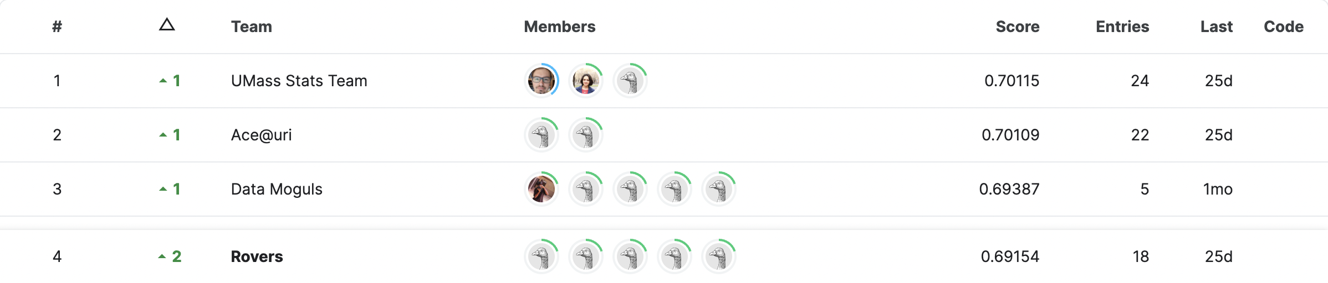
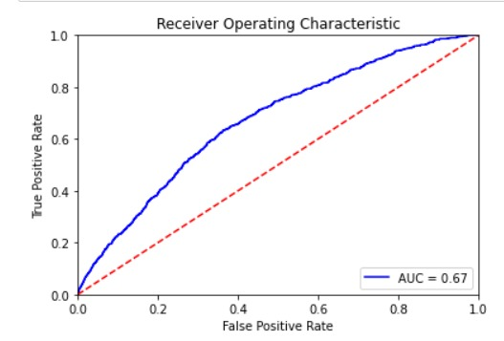

Peace of Mind
MODEL EVALUATION
AUC
11
Notes:
Next is model evaluation.
Team Rovers scored .69154 for the AUC on the test data.
In plain English, this is the probability of correctly identifying policies that Peace of Mind tends to write.
Down below, we have the ROC curve for the validation data. The AUC value is .67, which is lower than that of the test dataset above.
The difference of the AUC value is important.
The AUC score is higher on the test dataset, which indicates there is no overfitting of the model.
This means our model works better on unknown data, in other words, good for predictions in the future.

Slide 12
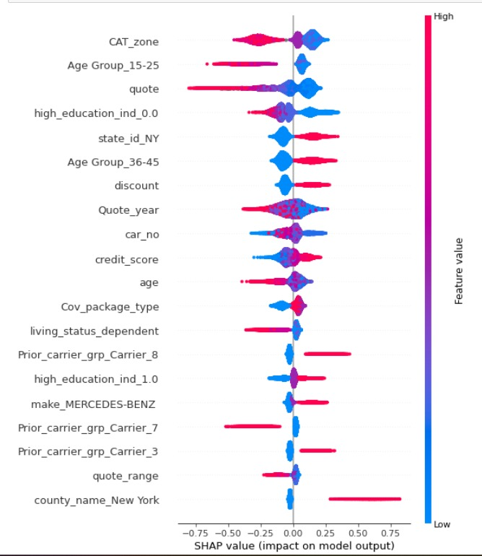
Peace of Mind
FINDINGS
Unlikely to convert
Likely to convert
Higher CAT zones
Higher quote
More individuals with education indicator as 0
Policies not having individuals in age group 15-25
Higher Vehicle age
higher living status dependency
Having prior carrier group_7
Lower credit score
Customers in lower CAT zones
Lower quotes
State ID NY
More individuals with education indicator as 1
Offered Discount
Prior carrier group 3 and 8
Higher credit score
Policies having customers in age group 36-45
CAT_zone
Age Group_15-25
quote
high_education_ind_0.0
state_id_NY
Age Group_36-45
discount
Quote_year
car_no
credit_score
12
Notes:
Let’s first look at the (name of graph).
The features are in the order of importance.
How to interpret this?
We look at where the color red is, either the left side of the baseline or the right side.
If red is on the left, the feature negatively affects conversion rate, and vice versa
A
On the left, we have summarized the features that make a policy likely to convert.
CAT zone has highest feature importance (lower CAT, higher chance of conversion, 2 or lower increases the chance of conversion by at least 5% on average)
Should not focus on age group 15-25 (lower conversions), focus on 36-45
Higher quote, lower conversions
B
On the other hand, we have features that make a policy UN-likely to convert.
high CAT zones
higher quotes
higher vehicle age
higher living living status dependency
ALL make policies less likely to convert.

Slide 13
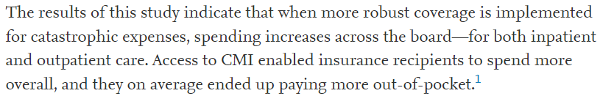
Peace of Mind
RECOMMENDATIONS
customers in New York in lower CAT zones
families in the 36~45 age bracket and NOT in the 15~25
policies should have discounts and lower quotes to increase conversion rate of customers with high credit scores
avoid customers having cars of age greater than 10
pursue higher education customers who either own/rent homes + NOT dependent
Target customers in New York living in lower CAT zones
sciencedirect.com
https://tinyurl.com/277v8bs8
13
Notes:
Target customers in New York living in lower CAT zones
https://www.sciencedirect.com/science/article/pii/S2666606521000833
https://www.cms.gov/CCIIO/Resources/Regulations-and-Guidance/Downloads/Auto_Renew_Catastrophic_Guidance.pdf

Slide 14
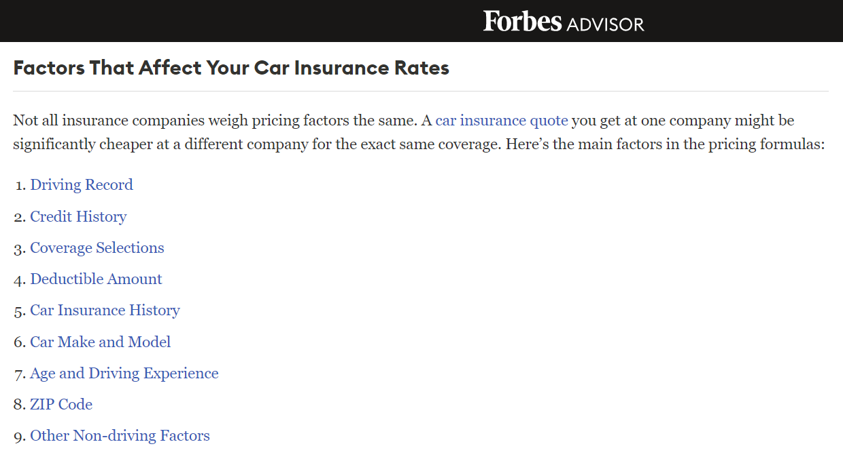
Peace of Mind
RECOMMENDATIONS
Focus on families with more individuals in the 36-45 age brackets and not in 15-25 age bracket
Policies should be offered at discount and have lower quotes to increase conversions to customers with high credit scores.
Customers having extremely old cars should be avoided
Pursue higher educated customers who either own or rent homes and are not dependent.
https://www.forbes.com/advisor/car-insurance/factors-in-rates/
14

Slide 15
Peace of Mind
FEATURE ADDITIONS
Discount Percentage
Prior Insurance Quote
Annual Income
Agent rating / Experience
Car Price
Driver Marital Status
15

Slide 16
Peace of Mind
TASK SPECIALIZATION
Shailesh Yadav
Ping-Jui Han
Nikhil Uttarwar
Vasudha Mishra
Heedong Park
Model Development
Findings
Model Evaluation
Data Cleaning
Insights
16

Slide 17
Peace of Mind
Q&A
THANK YOU
Team Rovers
Shailesh Yadav
Ping-Jui Han
Nikhil Uttarwar
Vasudha Mishra
Heedong Park

